Slide 1
Распознавание лиц

Slide 2
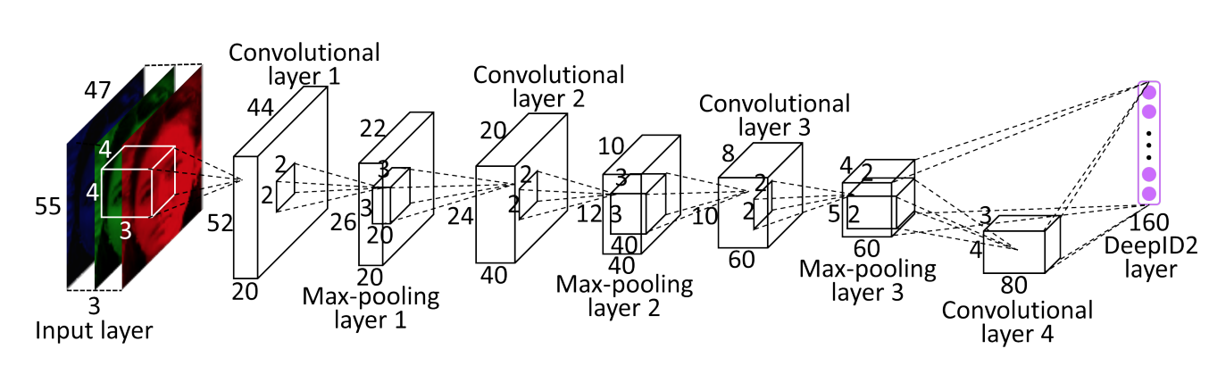
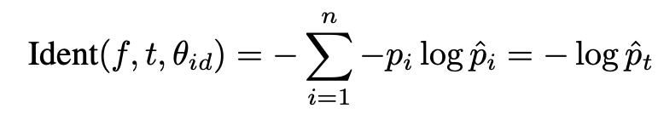
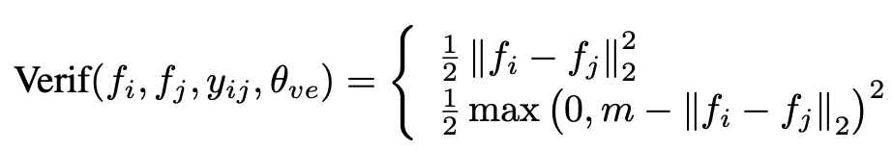
Векторные представления изображений лиц
Sun, Yi, et al. "Deep learning face representation by joint identification-verification." Advances in neural information processing systems 27 (2014).

Slide 3
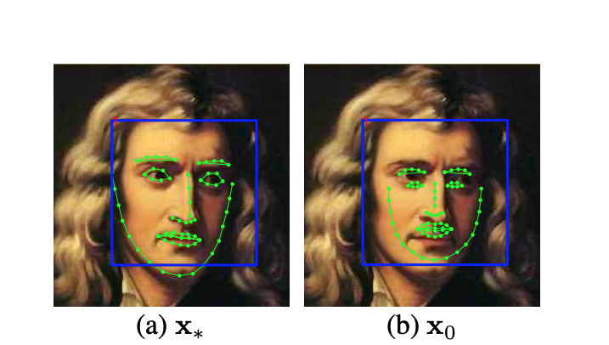


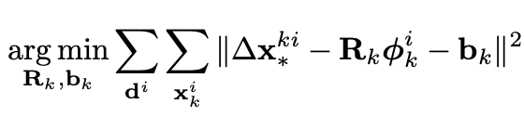
Выравнивание лиц
вектор гистограммы ориентированных градиентов, для i-ой точки шаблона на k-ой итерации
вектор смещения в сторону истинного значения для i-ой точки шаблона на k-ой итерации
Xiong, Xuehan, and Fernando De la Torre. "Supervised descent method and its applications to face alignment." Proceedings of the IEEE conference on computer vision and pattern recognition. 2013.

Slide 4
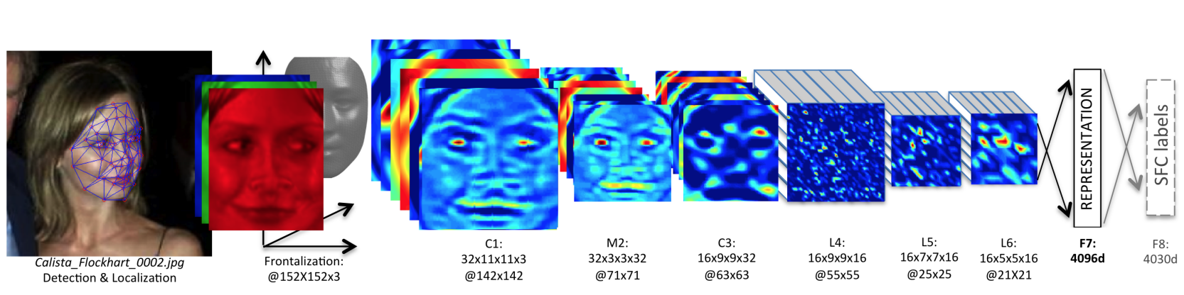
Выравнивание лиц
Taigman, Yaniv, et al. "Deepface: Closing the gap to human-level performance in face verification." Proceedings of the IEEE conference on computer vision and pattern recognition. 2014.

Slide 5
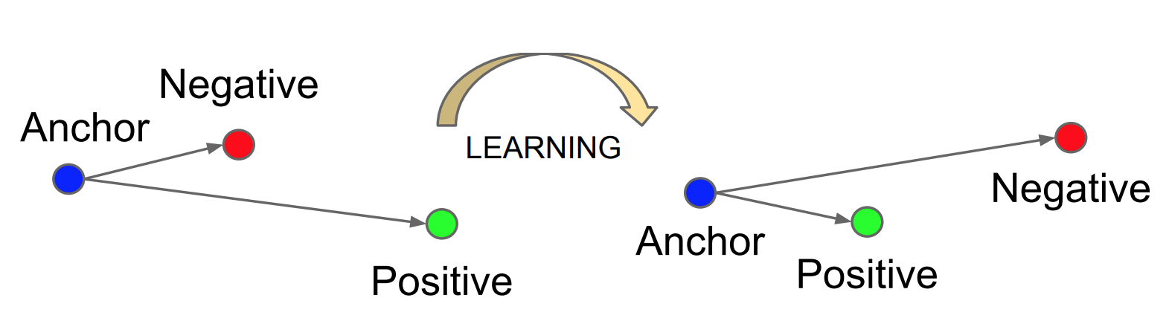

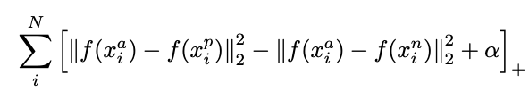
FaceNet & triplet loss
Schroff, Florian, Dmitry Kalenichenko, and James Philbin. "Facenet: A unified embedding for face recognition and clustering." Proceedings of the IEEE conference on computer vision and pattern recognition. 2015.

Slide 6
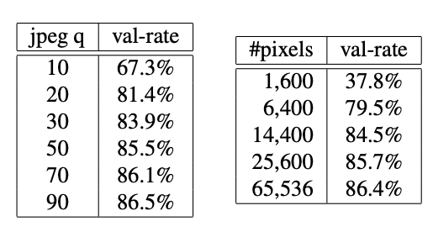
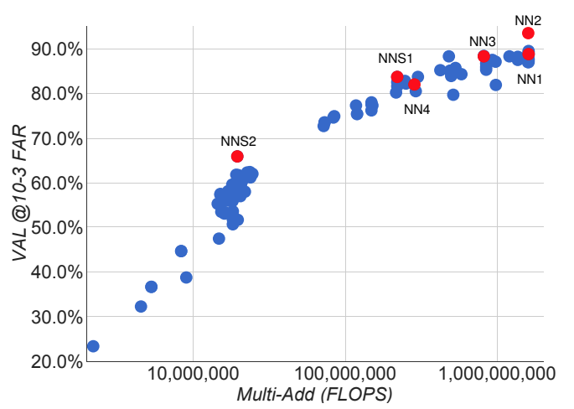
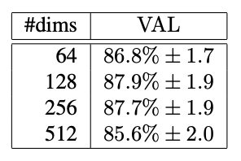
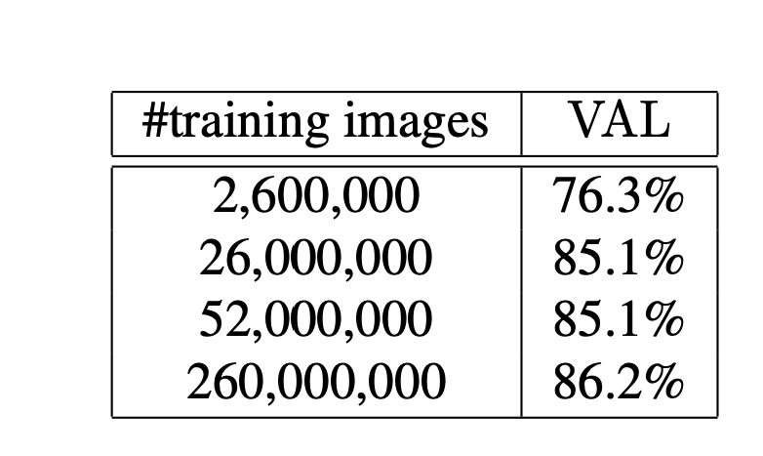
Влияние различных факторов
Schroff, Florian, Dmitry Kalenichenko, and James Philbin. "Facenet: A unified embedding for face recognition and clustering." Proceedings of the IEEE conference on computer vision and pattern recognition. 2015.

Slide 7
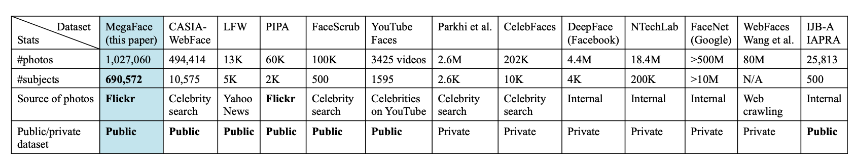
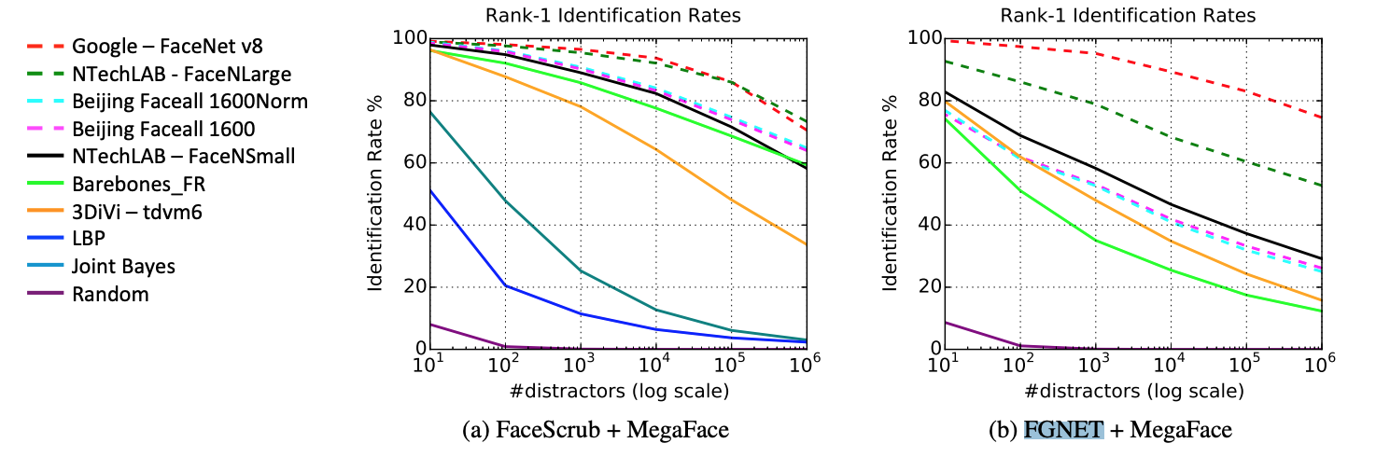
Базы данных
Kemelmacher-Shlizerman, Ira, et al. "The megaface benchmark: 1 million faces for recognition at scale." Proceedings of the IEEE conference on computer vision and pattern recognition. 2016.

Slide 8
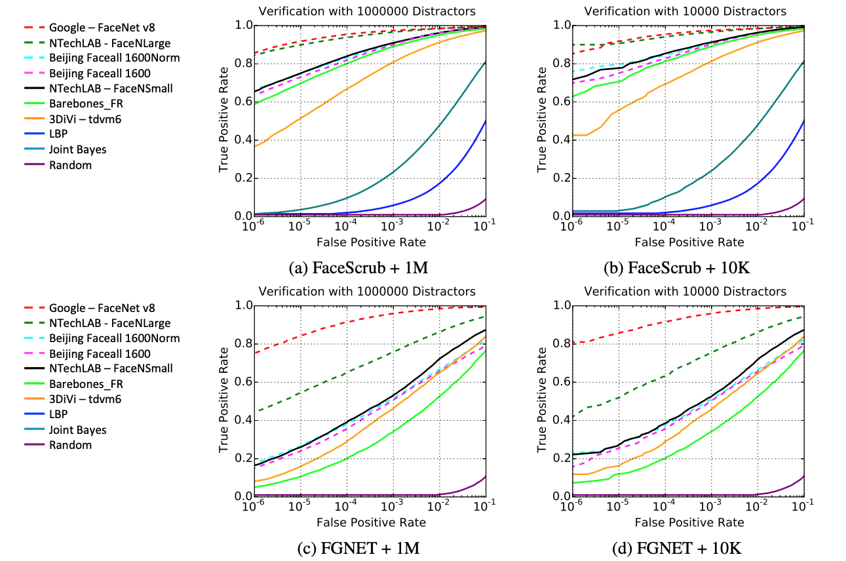
Сложность больших баз данных
Kemelmacher-Shlizerman, Ira, et al. "The megaface benchmark: 1 million faces for recognition at scale." Proceedings of the IEEE conference on computer vision and pattern recognition. 2016.

Slide 9
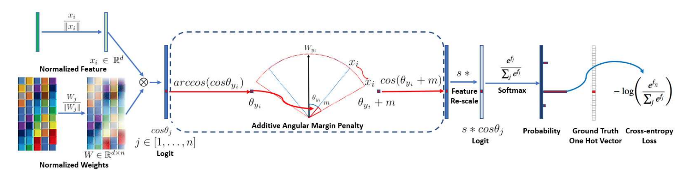
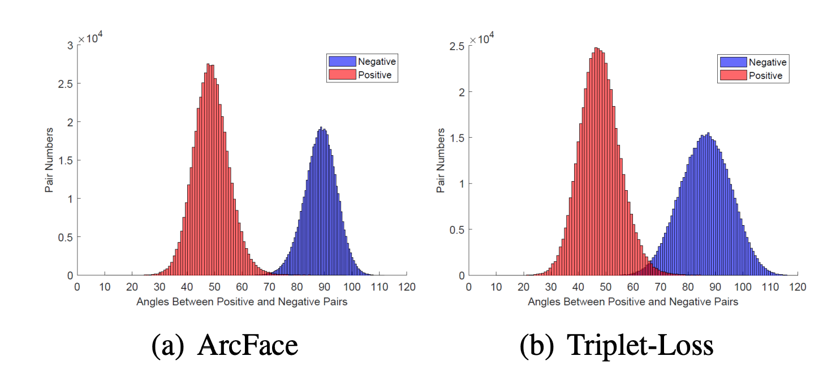
Распознавание лиц и сферические проекции
Deng, Jiankang, et al. "Arcface: Additive angular margin loss for deep face recognition." Proceedings of the IEEE/CVF conference on computer vision and pattern recognition. 2019.

